Slide 1
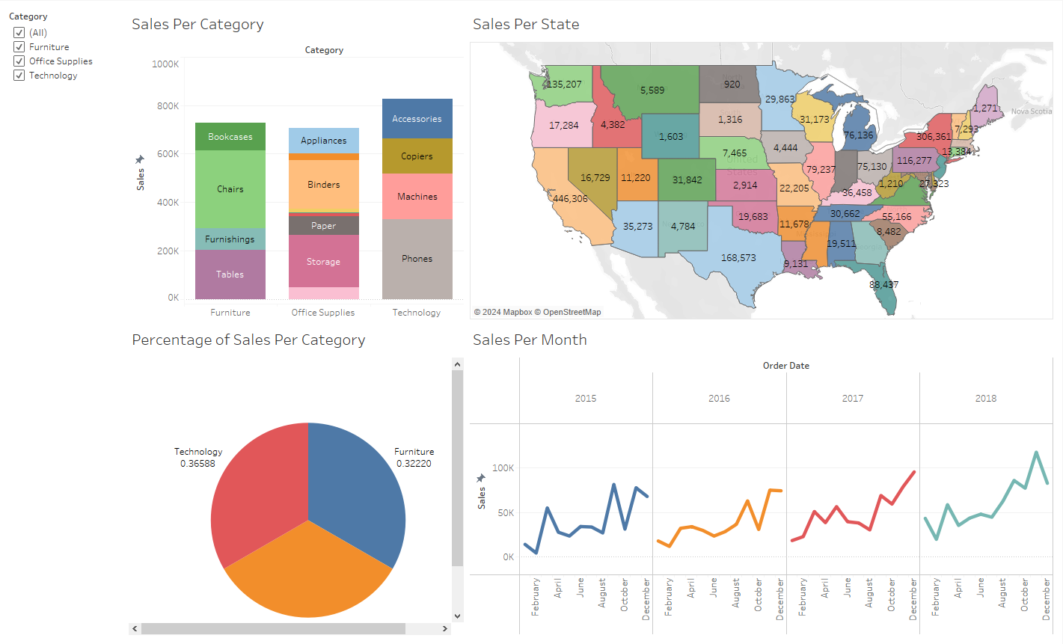
Tableau Portfolio Project
An Overview into the process

Slide 2
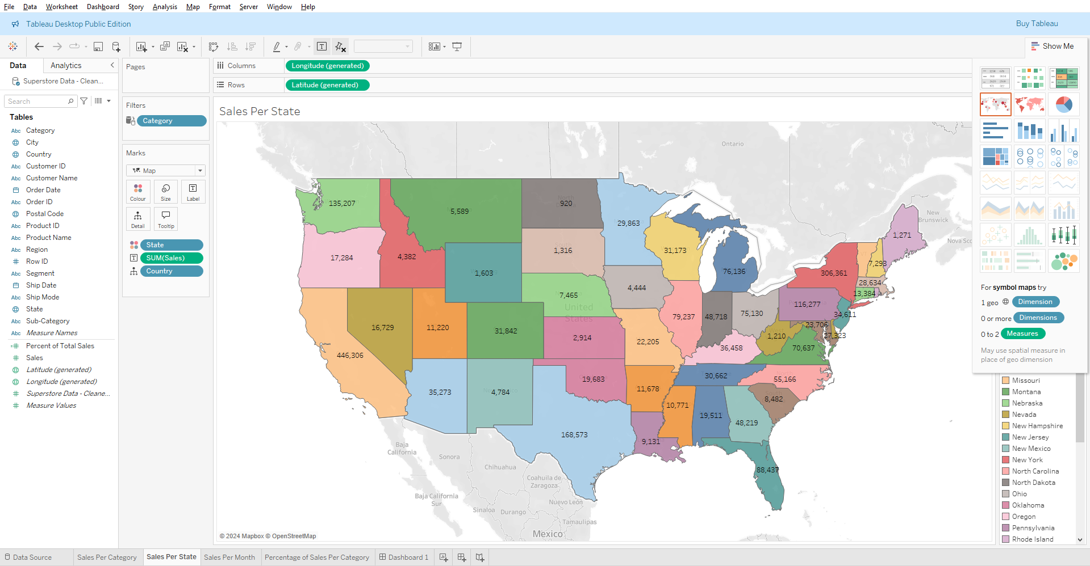
Project Aims
Tableau is a uniquely beneficial tool for data analysis as its wide plethora of graph options and visual fidelity can create stunning data visualisations that have the potential to impress and inform audiences. This time, I will be looking at the dataset of a superstore and using Tableau’s tools to create engaging dashboards.

Slide 3
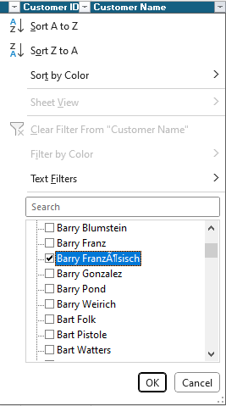
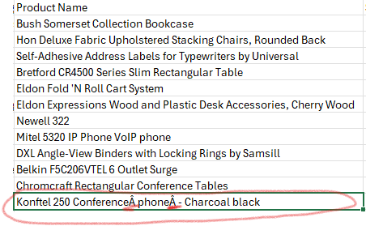
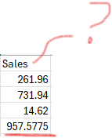
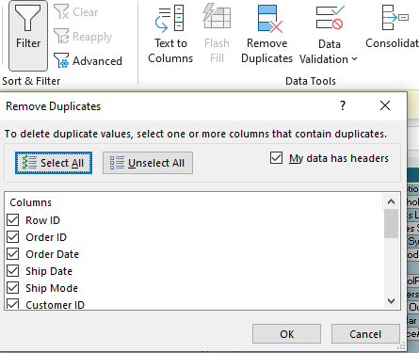
Cleaning my data
Starting out in Excel, I needed to ensure the data I had was of a good enough quality to use, formatting dates and values, handling null values and typos, and renaming any columns to make them easier to understand. Duplicates were also a concern – turning the dataset into a table allowed me to manipulate it on a grander scale, removing any duplicates in the over 10000 records this dataset consists of. Making it a table also allowed me to filter each column to find any anomalous values, choosing to either amend them or cut them from the dataset.

Slide 4
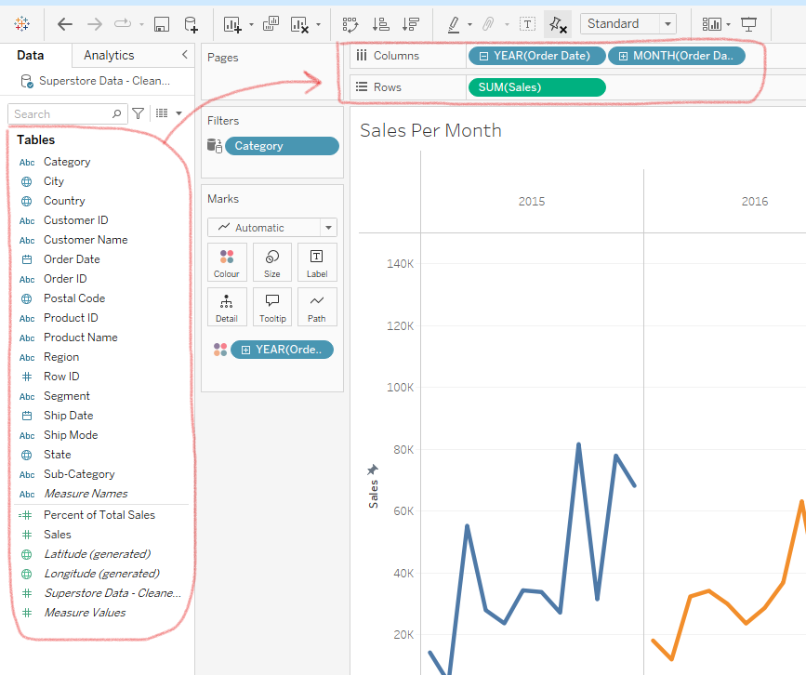
Tableau Interface
With my data clean and presented as a csv, I imported it into Tableau where I had easy access to all the table fields and could combine them together in different ways, including in maps. The interface clearly listed all the columns I cleaned in Excel, so creating the best combination of graph type and fields was a matter of experimentation. Once I had each graph in a different sheet, I could combine them all seamlessly into a dashboard and incorporate slicers to begin with analysis and presentation.

Slide 5
Key Insights
There is an almost equal demand for all categories of sales, and the amount of sales has been on an upward trend across the time span.
Very little sales are made in the earlier months, picking up around springtime and peaking at around the holiday season. Could there be value in launching an ad campaign in the early quarters to keep our brand fresh in their heads? What makes people want to order later on in the year?
The states with the most sales in the time span include California at 446k, New York at 306k, and Texas at 168k, meanwhile North Dakota has the lowest amount of sales at only 920. We should review what promotional efforts we are making in North Dakota. Is there a competitive market for the products we sell that is making it difficult to have an impact in that state?

Slide 6
What to do differently
If I were to do this task again, I would see about adding filtering options to analyse singular products to see how each of them perform independently.

